Slide 1
OPERATING SYSTEM
Name: Dr. Rita Roy
Assistant Professor
Department of CSE
GITAM School of Technology (GST)
Visakhapatnam – 530045

Slide 2
CHAPTER -1
UNIT 1 Operating system Structures: 8 hours
Introduction: What operating systems do, computer system organization, computer system architecture, operating system structure, resource management, Protection and security, kernel data structures.
Operating system Structures: operating system services, system calls, loaders and linkers, operating system structure, building and booting an operating system.

Slide 3
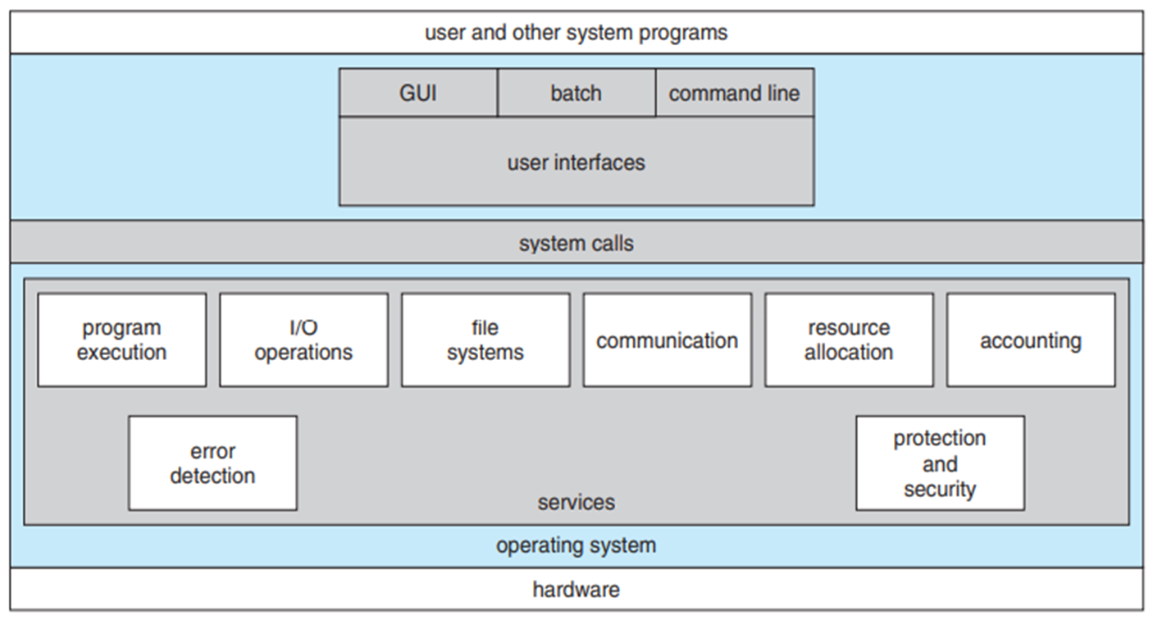
Operating-System Services
An operating system provides an environment for the execution of programs. It provides certain services to programs and to the users of those programs.

Slide 4
Operating-System Services
User interface: The interface is a window system with a pointing device to direct I/O, choose from menus, and make selections and a keyboard to enter text. Ex: command-line interface, batch interface, graphical user interface (GUI).
Program execution: The system must be able to load a program into memory and to run that program.
I/O operations: A running program may require I/O, which may involve a file or an I/O device.

Slide 5
Operating-System Services
File-system manipulation: programs need to read and write files and directories. They also need to create and delete them by name, search for a given file, and list file information.
Communications: one process needs to exchange information with another process. Such communication may occur between processes that are executing on the same computer or between processes that are executing on different computer systems tied together by a computer network. Communications may be implemented via shared memory or message passing.

Slide 6
Operating-System Services
6. Error detection: The operating system needs to be detecting and correcting errors constantly. Errors may occur in the CPU and memory hardware, in I/O devices and in the user program. For each type of error, the operating system should take the appropriate action to ensure correct and consistent computing.
Another set of operating system functions exists not for helping the user but rather for ensuring the efficient operation of the system itself.
Resource allocation: When there are multiple users or multiple jobs running at the same time, resources must be allocated to each of them. The operating system manages many different types of resources.

Slide 7
User and Operating-System Interface
Accounting: We want to keep track of which users use how much and what kinds of computer resources.
Protection and security:
Command Interpreters:
Windows and UNIX, treat the command interpreter as a special program that is running when a job is initiated or when a user first logs on, the interpreters are known as shells.
Ex: UNIX and Linux systems shells → Bourne shell, C shell, Bourne-Again shell, Korn shell.

Slide 8
The main function of the command interpreter is to get and execute the next user-specified command. These commands can be implemented in two general ways.
First one is the command interpreter itself contains the code to execute the command.
Second one is used by UNIX, In this case, the command interpreter does not understand the command in any way; it merely uses the command to identify a file to be loaded into memory and executed.
Ex: rm file.txt

Slide 9
Graphical User Interfaces
Here, rather than entering commands directly via a command-line interface, users employ a mouse-based window and menu system characterized by a desktop metaphor.
The first GUI appeared on the Xerox Alto computer in 1973.
Graphical interfaces became more widespread with the advent of Apple Macintosh computers in the 1980s.(Aqua)
Because a mouse is impractical for most mobile systems, smartphones and handheld tablet computers typically use a touchscreen interface. Here, users interact by making gestures on the touchscreen.

Slide 10
K Desktop Environment (or KDE) and the GNOME desktop by the GNU project, run on Linux and various UNIX systems and are available under open-source licenses
Choice of Interface
System administrators who manage computers and power users who have deep knowledge of a system frequently use the command-line interface.
These shell scripts are very common on systems that are command-line oriented, such as UNIX and Linux.

Slide 11
Most Windows users are happy to use the Windows GUI environment and almost never use the MS-DOS shell interface.
Mac OS X (which is in part implemented using a UNIX kernel), the operating system now provides both an Aqua interface and a command-line interface.
The user interface can vary from system to system and even from user to user within a system.

Slide 12
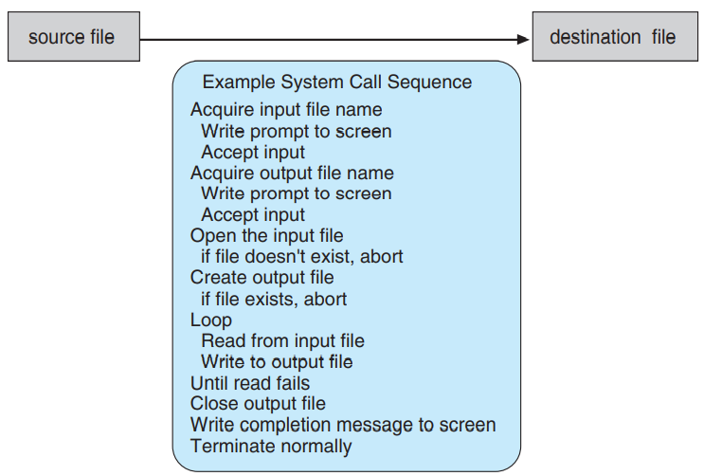
System Calls
System calls provide an interface to the services made available by an operating system.
These calls are generally available as routines written in C and C++, certain low-level tasks written using assembly-language instructions.

Slide 13
Illustration of system calls → Ex: writing a simple program to read data from one file and copy them to another file.
As you can see, even simple programs may make heavy use of the operating system. Frequently, systems execute thousands of system calls per second.
The API(application programming interface) specifies a set of functions that are available to an application programmer, including the parameters that are passed to each function and the return values the programmer can expect.
Windows API for Windows systems, the POSIX API for POSIX-based systems (which include virtually all versions of UNIX, Linux, and Mac OS X), and the Java API for programs that run on the Java virtual machine.

Slide 14
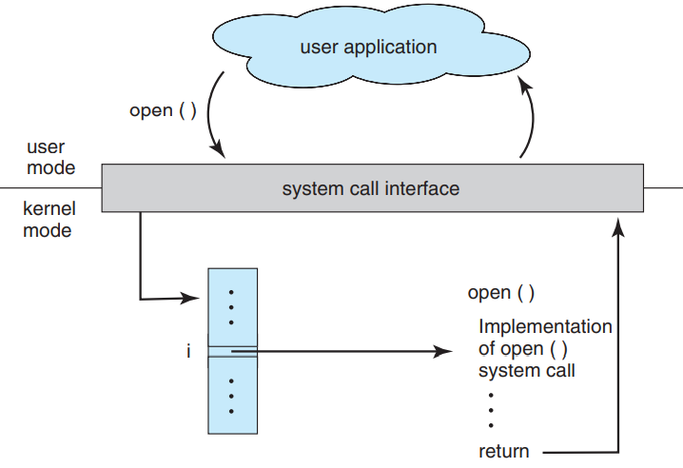
Behind the scenes, the functions that make up an API typically invoke the actual system calls on behalf of the application programmer.
The system-call interface intercepts function calls in the API and invokes the necessary system calls within the operating system.
Typically, a number is associated with each system call, and the system-call interface maintains a table indexed according to these numbers.

Slide 15
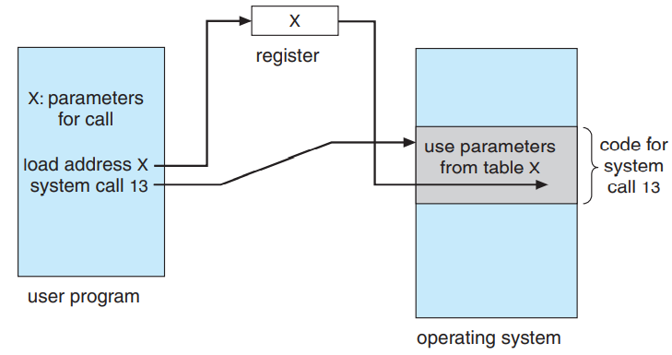
Most of the details of the operating-system interface are hidden from the programmer by the API and are managed by the run-time support library.
System calls occur in different ways, depending on the computer in use.
The exact type and amount of information vary according to the particular operating system and call.

Slide 16
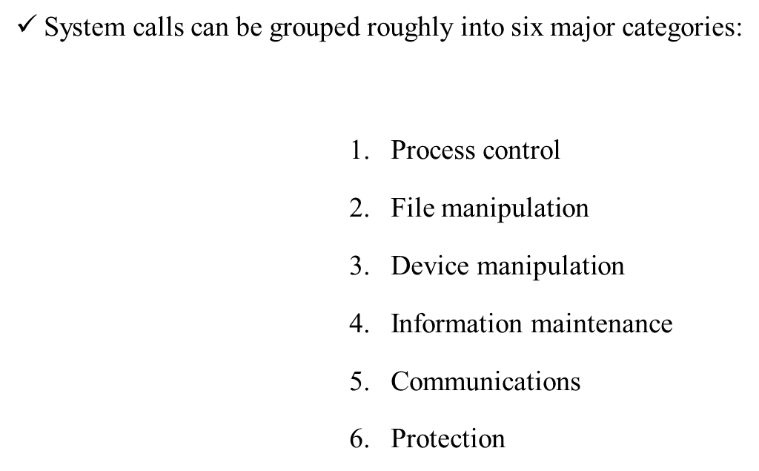
Three general methods are used to pass parameters to the operating system. The simplest approach is to pass the parameters in registers.
Types of System Calls

Slide 17
Types of System Calls
Process Control:
end, abort
load, execute
create process, terminate process
get process attributes, set process attributes
wait for time
wait event, signal event
allocate and free memory
File management:
create file, delete file
open, close
read, write, reposition
get file attributes, set file attributes

Slide 18
Types of System Calls
Device management:
request device, release device
read, write, reposition
get device attributes, set device attributes
logically attach or detach devices
Information maintenance:
get time or date, set time or date
get system data, set system data
get process, file, or device attributes
set process, file, or device attributes

Slide 19
Types of System Calls
There are two common models of inter-process communication: the message-passing model and the shared-memory model. In the message-passing model, the communicating processes exchange messages with one another to transfer information.
Ex:get_hostid(), get_processid(), open() and close(), open_connection() and close_connection(), accept_ connection(), wait_for_connection()
In the shared-memory model, processes use shared memory create() and shared memory attach() system calls to create and gain access to regions of memory owned by other processes.
Protection provides a mechanism for controlling access to the resources provided by a computer system.

Slide 20
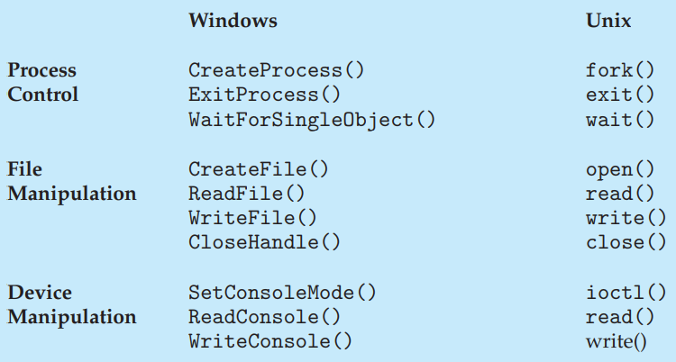
EXAMPLES OF WINDOWS AND UNIX SYSTEM CALLS

Slide 21
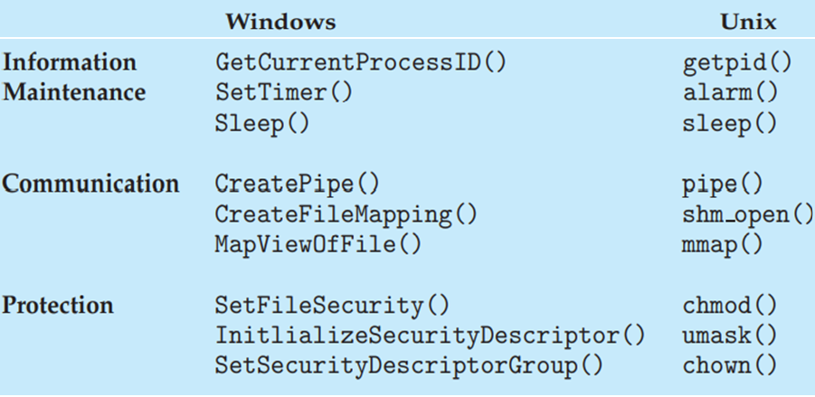

Slide 22
System Programs
System programs, also known as system utilities, provide a convenient environment for program development and execution.
File management: These programs create, delete, copy, rename, print, dump, list, and generally manipulate files and directories.
Status information: Some programs simply ask the system for the date, time, amount of available memory or disk space, number of users, or similar status information. Others are more complex, providing detailed performance, logging, and debugging information.
File modification: Several text editors may be available to create and modify the content of files stored on disk or other storage devices. There may also be special commands to search contents of files or perform transformations of the text.

Slide 23
System Programs
Programming-language support: Compilers, assemblers, debuggers, and interpreters for common programming languages (such as C, C++, Java, and PERL) are often provided with the operating system or available as a separate download.
Program loading and execution: Once a program is assembled or compiled, it must be loaded into memory to be executed. The system may provide absolute loaders, relocatable loaders, linkage editors, and overlay loaders. Debugging systems for either higher-level languages or machine language are needed as well.
Communications: These programs provide the mechanism for creating virtual connections among processes, users, and computer systems.
Background services: Constantly running system-program processes are known as services, subsystems, or daemons.

Slide 24
Operating-System Structure
A system as large and complex as a modern operating system must be engineered carefully if it is to function properly and be modified easily.
A common approach is to partition the task into small components, or modules, rather than have one monolithic system.
Each of these modules should be a well-defined portion of the system, with carefully defined inputs, outputs, and functions.

Slide 25
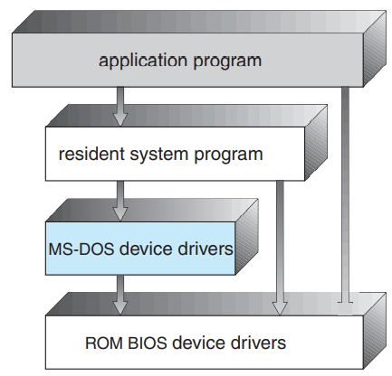
Simple Structure
In MS-DOS, the interfaces and levels of functionality are not well separated.
For instance, application programs are able to access the basic I/O routines to write directly to the display and disk drives.
Such freedom leaves MS-DOS vulnerable to errant (or malicious) programs, causing entire system crashes when user programs fail.
Of course, MS-DOS was also limited by the hardware of its era.

Slide 26
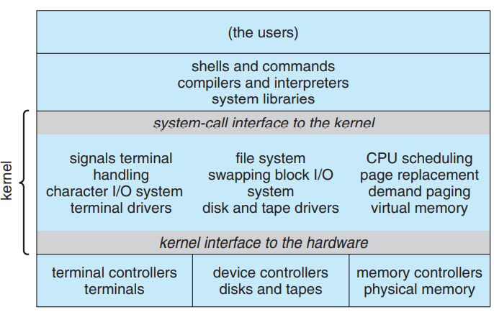
Like MS-DOS, UNIX initially was limited by hardware functionality.
It consists of two separable parts: the kernel and the system programs.
The kernel is further separated into a series of interfaces and device drivers, which have been added and expanded over the years as UNIX has evolved.

Slide 27
Layered Approach
With proper hardware support, operating systems can be broken into pieces that are smaller and more appropriate than those allowed by the original MS-DOS and UNIX systems.
The operating system can then retain much greater control over the computer and over the applications that make use of that computer.
A system can be made modular in many ways. One method is the layered approach, in which the operating system is broken into a number of layers (levels).
The bottom layer (layer 0) is the hardware; the highest (layer N) is the user interface.

Slide 28
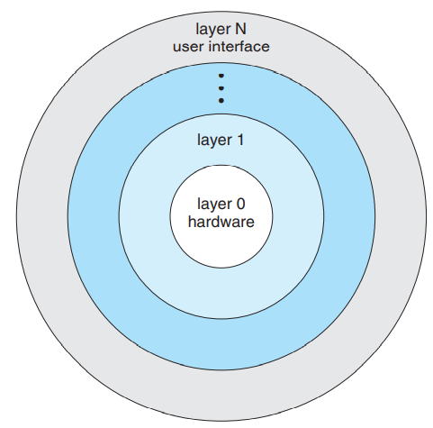

Slide 29
Contd.
The main advantage of the layered approach is simplicity of construction and debugging.
The layers are selected so that each uses functions (operations) and services of only lower-level layers.
This approach simplifies debugging and system verification.
The first layer can be debugged without any concern for the rest of the system, because, by definition, it uses only the basic hardware (which is assumed correct) to implement its functions.
Once the first layer is debugged, its correct functioning can be assumed while the second layer is debugged, and so on.

Slide 30
Contd.
The major difficulty with the layered approach involves appropriately defining the various layers.
Because a layer can use only lower-level layers, careful planning is necessary.
Another major problem with layered implementations is that they tend to be less efficient than other types.
Each layer adds overhead to the system call. The net result is a system call that takes longer than does one on a non-layered system.

Slide 31
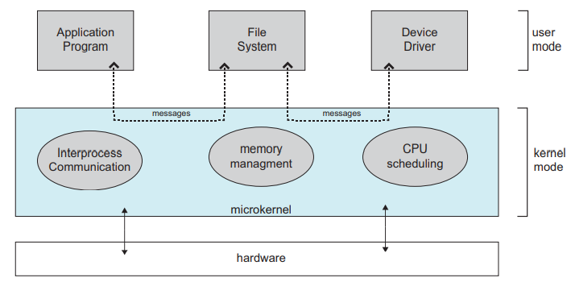
Microkernels
In the mid-1980s, researchers at Carnegie Mellon University developed an operating system called Mach that modularized the kernel using the microkernel approach.
This method structures the operating system by removing all nonessential components from the kernel and implementing them as system and user-level programs. The result is a smaller kernel.

Slide 32
Contd…
The main function of the microkernel is to provide communication between the client program and the various services that are also running in user space.
Communication is provided through message passing.
One benefit of the microkernel approach is that it makes extending the operating system easier.
All new services are added to user space and consequently do not require modification of the kernel.
The microkernel also provides more security and reliability, since most services are running as user—rather than kernel— processes.
Unfortunately, the performance of microkernels can suffer due to increased system-function overhead.

Slide 33
Modules
loadable kernel modules: Here, the kernel has a set of core components and links in additional services via modules, either at boot time or during run time.
The idea of the design is for the kernel to provide core services while other services are implemented dynamically, as the kernel is running.
Linking services dynamically is preferable to adding new features directly to the kernel, which would require recompiling the kernel every time a change was made.
The overall result resembles a layered system in that each kernel section has defined, protected interfaces; but it is more flexible than a layered system, because any module can call any other module.

Slide 34
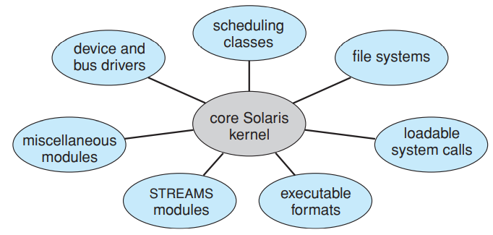
CONTD...
The approach is also similar to the microkernel approach in that the primary module has only core functions and knowledge of how to load and communicate with other modules; but it is more efficient, because modules do not need to invoke message passing in order to communicate.

Slide 35
Hybrid Systems
Linux and Solaris are monolithic, because having the operating system in a single address space provides very efficient performance.
However, they are also modular, so that new functionality can be dynamically added to the kernel.
Windows is largely monolithic as well (again primarily for performance reasons), but it retains some behavior typical of microkernel systems, including providing support for separate subsystems (known as operating-system personalities) that run as user-mode processes.
Windows systems also provide support for dynamically loadable kernel modules.

Slide 36
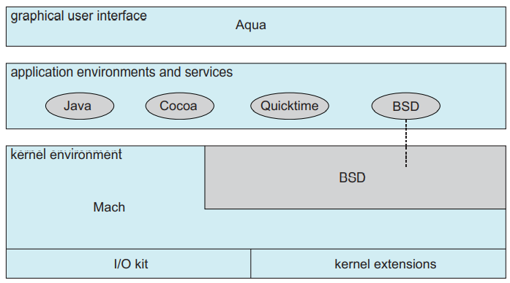
1. Mac OS X
The Apple Mac OS X operating system uses a hybrid structure.
The top layers include the Aqua user interface and a set of application environments and services.
Below these layers is the kernel environment, which consists primarily of the Mach microkernel and the BSD UNIX kernel.

Slide 37
Mach provides memory management; support for remote procedure calls (RPCs) and inter-process communication (IPC) facilities, including message passing; and thread scheduling.
In addition to Mach and BSD, the kernel environment provides an I/O kit for development of device drivers and dynamically loadable modules.

Slide 38
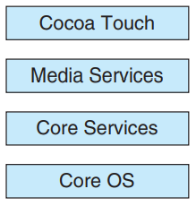
2. iOS
iOS is a mobile operating system designed by Apple to run its smartphone, the iPhone, as well as its tablet computer, the iPad.
iOS is structured on the Mac OS X operating system, with added functionality pertinent to mobile devices, but does not directly run Mac OS X applications.
Cocoa Touch is an API for Objective-C that provides several frameworks for developing applications that run on iOS devices.
The media services layer provides services for graphics, audio, and video.
The core services layer provides a variety of features, including support for cloud computing and databases.

Slide 39
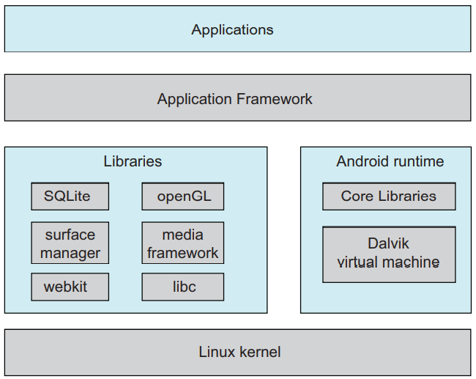
2. Android
The Android operating system was designed by the Open Handset Alliance (led primarily by Google) and was developed for Android smartphones and tablet computers.
Linux is used primarily for process, memory, and device-driver support for hardware and has been expanded to include power management.
The Android runtime environment includes a core set of libraries as well as the Dalvik virtual machine

Slide 40
CONTD…
Software designers for Android devices develop applications in the Java language.
However, rather than using the standard Java API, Google has designed a separate Android API for Java development, the executable file that runs on the Dalvik virtual machine.
The set of libraries available for Android applications includes frameworks for developing web browsers (webkit), database support (SQLite), and multimedia.
The libc library is similar to the standard C library but is much smaller.

Slide 41
System Boot
How does the hardware know where the kernel is or how to load that kernel?
The procedure of starting a computer by loading the kernel is known as booting the system.
On most computer systems, a small piece of code known as the bootstrap program or bootstrap loader locates the kernel, loads it into main memory, and starts its execution.

Slide 42
CONTD..
Some computer systems, such as PCs, use a two-step process in which a simple bootstrap loader fetches a more complex boot program from disk, which in turn loads the kernel.
When it is powered up or rebooted—the instruction register is loaded with a predefined memory location, and execution starts there. At that location is the initial bootstrap program.
This program is in the form of read-only memory (ROM), because it needs no initialization and cannot easily be infected by a computer virus.
Bootstrap program can also initialize all aspects of the system, from CPU registers to device controllers and the contents of main memory. Sooner or later, it starts the operating system.

Slide 43
System boot
Some systems—such as cellular phones, tablets, and game consoles—store the entire operating system in ROM.
All forms of ROM are also known as firmware, since their characteristics fall somewhere between those of hardware and those of software.
A problem with firmware in general is that executing code there is slower than executing code in RAM.
Some systems store the operating system in firmware and copy it to RAM for fast execution.

Slide 44
Contd…
A final issue with firmware is that it is relatively expensive, so usually only small amounts are available.
The bootstrap runs diagnostics and has a bit of code that can read a single block at a fixed location (say block zero) from disk into memory and execute the code from that boot block.
A disk that has a boot partition is called a boot disk or system disk.

Slide 45
THANK YOU

